Slide 1

to Year 9 Options Evening
Madeline Budner
Senior Assistant Principal

Slide 2
Purpose of this evening
• To provide information about the whole curriculum offer
• The provide information about the process with key dates and information
To meet and talk to the teachers and key staff who will provide support and guidance

Slide 3
Sources of Information
Options booklet
Subject Staff - parents evening
Mr Hunneyball, Mrs Taylor
Form Tutor & Mrs Budner (myself)
Parents & Family

Slide 4
Compulsory Core Curriculum
English Language 1 GCSE
English Literature 1 GCSE
Mathematics 1 GCSE
Statistics 1 GCSE (for most students)
Science 2 GCSEs - Combined Science (Trilogy)
Separate Science (Biology, Chemistry, Physics) is available for some students
Core Physical Education
RE/PSHE/Careers
+ 3 options

Slide 5
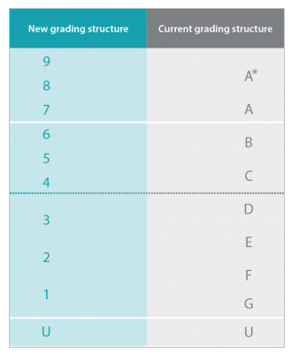
All GCSE will be graded 1-9, with 8 being the same as a A* and a 4 begin the same as the C grade.
Our current results from last years year 11, were very positive and above national average. Students far exceeded the progress expected of them
We came 5th in the city out of 15.

Slide 6
GCSE courses contain a larger externally examined content than OCR nationals or BTEC’s
• Most GCSE subjects are ONLY examined at the end of year 11 - Summer 2027
• Art contains an internally assessed unit built up over 2 years as well as a final exam.
Detail within booklets and discussions with staff

Slide 7

Grade 4 and 5 in English and Maths
Grades 4/5 in English and Maths remain a key standard
It will continue to be a key minimum requirement for many courses, apprenticeships & jobs

Slide 8
The Ebacc:
English Baccalaureate (Ebacc) introduced in 2011 with the aim of keeping young people’s options open for further study.
  Achieved when a student gains:
  Grade 5 (or above) in
  English
  Maths
  Sciences
  Language
  History or Geography

Slide 9
Guidelines
You must choose 1 subject and a reserve choice from the first column
You then need to choose 4 further options – put them in order of the one you would most like to study – you will get two of these.

Slide 10
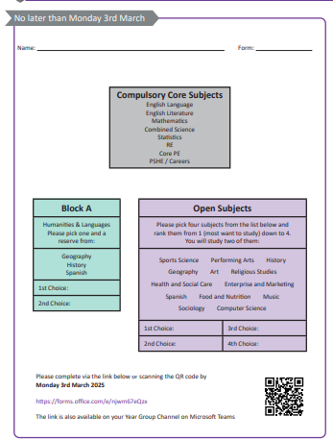
These need to be completed by Monday 3rd March.
Link to the form will be in year group team
Mrs Budner

Slide 11
Key dates
Deadline for Options forms Monday 3rd March
Confirmed choices July 2025

Slide 12
Will I get all of my choices?
• Courses can only run if enough people choose them • Some courses may be over subscribed so some of you will get your reserve choice
• It is rare that there are clashes where you cannot do any of your 1st and 2nd choices
• I will be asking to see you individually after the 3rd of March if there is an issue

Slide 13
DO
Speak to your subject teachers/Tutor
Speak to your parents
Think about whether you are more suited to GCSE or OCR or BTEC
Choose a subject you
• Like
• Reflects your interests and personal qualities
• Helps you learn in the best way for you
• Helps keep your options open for the future

Slide 14
Don’t
Choose subjects because your friends are taking them
Choose subjects because you think they are an easy option
Choose subjects because you like the teacher
Choose subjects that you don’t like

