Slide 1


YEAR 11 CENTRE ASSESSED GRADES SUMMER 2021
WHAT DO YOU NEED TO KNOW?

Slide 2

TIMELINE
15 Mar. 2021
In class assessments begin
23 Mar. 2021
All subjects release details of assessments
29 Mar. – 13 Apr. 2021
Easter Break
14 Apr.
In class assessments continue
4–14 May 2021
Formal Assessments in Exam Hall
18 June 2021
All CAGS submitted to OFQUAL
12 Aug. 2021
GCSE results Day

Slide 3
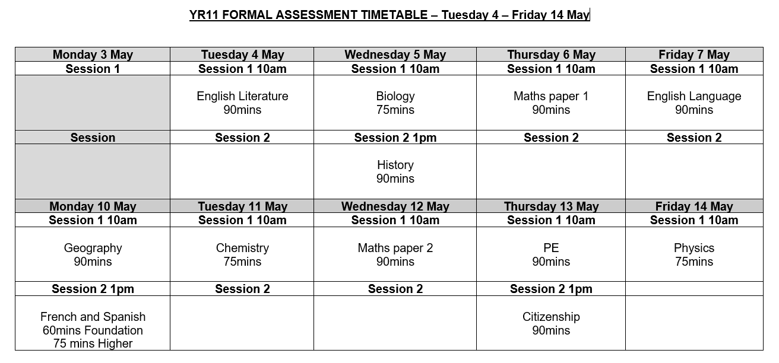

Slide 4





BTEC ART AND DESIGN
Your teacher will look at all the work that you have produced during the course – this will be your 'Portfolio', and could
be made up of finished projects, incomplete projects, or even individual tasks or pieces of work
Your portfolio will be assessed over three units you have completed (Design Brief Projects)…
Unit 1 – Introduction to Art & Design - Wildlife Park Design Brief - This unit was assessed externally at the start of Year 10.
Unit 4 – Communicating Ideas in 2D - Hotel Artwork Design Brief - Assessed by your teacher, using the work you complete in school
Unit 2 – External Brief- ‘Sweets’ or ‘Life and Work of’ Design Brief - Assessed by your teacher, using the work you complete in school.
BE KIND. WORK HARD.

Slide 5
GCSE ART AND DESIGN
Your teacher will look at all the work that you have produced during the course – this will be your 'Portfolio', and could
be made up of finished projects, incomplete projects, or even individual tasks or pieces of work
Your portfolio will be assessed on our four key skills areas (Assessment Objectives)…
EXPLORE the work of other artists - Researching, Analysing and Responding to their work
EXPERIMENT with Ideas, Materials and Techniques to create your own artwork
EXPLAIN your ideas – visually through drawing & photos, and textually through explanations & evaluations
EXPRESS a Personal Response to each theme that links back to previous work on that theme
BE KIND. WORK HARD.

Slide 6


OCR CHILD DEVELOPMENT
Assessment will be based upon coursework from the following units:
R019: Understand the equipment and nutritional needs of children from birth to five years
Key Topics to be assessed:
Learning Outcome 1: Understand the key factors when choosing equipment for babies from birth to 12 months
Learning Outcome 2: Understand the key factors when choosing equipment for children from one to five years
Learning Outcome 3: Know the nutritional guidelines and requirements for children from birth to five years
Learning Outcome 4: Be able to investigate and develop feeding solutions for children from birth to five years
Other assessments to be considered: In class assessments, multiple choice questions
BE KIND. WORK HARD.

Slide 7
OCR Creative iMedia
Assessment will be based upon coursework from the following units:
R087: Creating Interactive Multimedia Products
Key Topics to be assessed:
Learning Outcome 1: Identify interactive multimedia products
provide some information about the range of interactive multimedia products available, where they can be used and the hardware and software required.
Learning Outcome 2: Plan an interactive multimedia product
use appropriate planning techniques to identify the assets needed to create the interactive multimedia product
Learning Outcome 3: Create the interactive multimedia product
produce the interactive multimedia product for your local tourism board, using a range of assets, tools and techniques to ensure it is suitable for the brief.
Learning Outcome 4: Review the interactive multimedia product
consider whether you have met all the requirements of the initial brief
Other assessments to be considered: In class assessments, multiple choice questions
BE KIND. WORK HARD.

Slide 8
GCSE CITIZENSHIP
May Formal Assessment 90 minutes: Combination of questions from -
Paper 1 – Active Citizenship / Politics and Participation
Paper 2 – Life in Modern Britain / Rights and Responsibilities
Key Topics to be assessed:
Identity, immigration and media
International organisations and conflict
Laws in contemporary society
Democracy and power
Parliament & Law
Devolution and Government
Voting systems, Holding the government to account
Active Citizenship project (1 question)
Other assessments to be considered: November PPEs, in class assessments, multiple choice questions
BE KIND. WORK HARD.

Slide 9
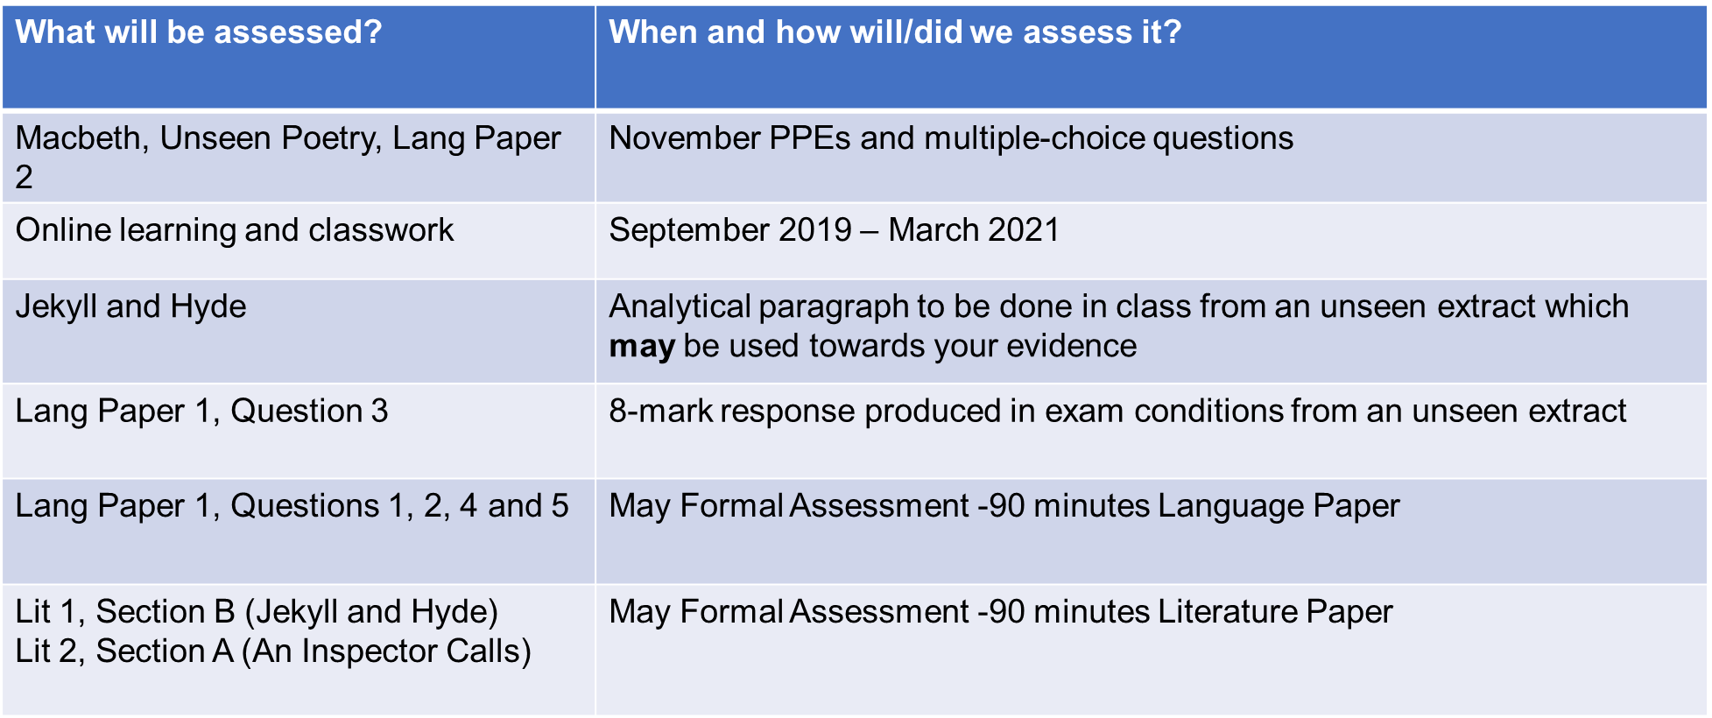
GCSE ENGLISH LITERATURE/LANGUAGE
BE KIND. WORK HARD.

Slide 10
OCR ENTERPRISE AND MARKETING
Evidence
Any coursework you have completed or part completed by the deadline date.
From both R065 and R066.
Coursework
All of the evidence will then be taken into account to come up with your CAG.
Approximately based 50% on any exam evidence and 50% on any coursework evidence. (Where available)
(As per the course requirements)
Any previous or future
PPE’s or exams. (R064)
(Those in school or set by the exam board)
PPE’s & Exams
Any classwork that has been completed for work towards the PPE’s, Exams or Coursework.
Classwork and MCQ’s
BE KIND. WORK HARD.

Slide 11
GCSE GEOGRAPHY
May Formal Assessment 90 minutes: Combination of questions from –
Paper 1 – Physical Geography.
Paper 2 – Human Geography.
Key Topics to be assessed:
Climate change.
Tectonic hazards.
Weather hazards.
Ecosystems.
Cold environments.
The Challenge of resource management – Energy.
Urban issues and challenges
Other assessments to be considered: November PPEs, in class assessments, multiple choice questions
BE KIND. WORK HARD.

Slide 12
OCR HEALTH AND SOCIAL CARE
Assessment will be based upon coursework from the following units:
R022: Communicating and working with individuals in health, social care and early years settings
R031: Using basic first aid procedures
Key Topics to be assessed:
R022:Learning Outcome 1: Understand how to communicate effectively
Learning Outcome 2: Understand the personal qualities that contribute to effective care
Learning Outcome 3: Be able to communicate effectively within a health, social care and early years setting
R031: Learning Outcome 1: Be able to assess scenes of accidents to identify risks and continuing dangers
Learning Outcome 2: Understand the first aid procedures for a range of injuries
Learning Outcome 3: Be able to apply basic first aid procedures
Other assessments to be considered: In class assessments, multiple choice questions
BE KIND. WORK HARD.

Slide 13

GCSE HISTORY
May Formal Assessment 90 minutes - Combination of questions from -
Paper 1 - Medicine Through Time
Paper 2 – Super Power Relations – The Cold War
Paper 3 – Weimar and Nazi Germany 1918-1938
Key Topics to be assessed:
Change and continuity in medicine from the Medieval era to present day.
The origins and development of the Cold War
Problems encountered by the Weimar Republic in 1923
Women in Nazi Germany
Other assessments to be considered: November PPEs, in class assessments, multiple choice questions
BE KIND. WORK HARD.

Slide 14
GCSE MATHEMATICS
Weekly Test 1
Weekly Test 2
Weekly Test 3
Weekly Test 4
Weekly Test 5
Students will be given topics a week in advance so will have chance to revise for these tests – Listed on the following page
Exam 1
90 Minutes
Calculator
Exam 2
90 Minutes
Non Calculator
Students will NOT be assessed on material that they have not had chance to study in lessons
The CAG will NOT be set entirely on the exam result. It will help form our evidence.
Professional decision made using evidence from weekly tests, exams & teacher assessment
BE KIND. WORK HARD.

Slide 15
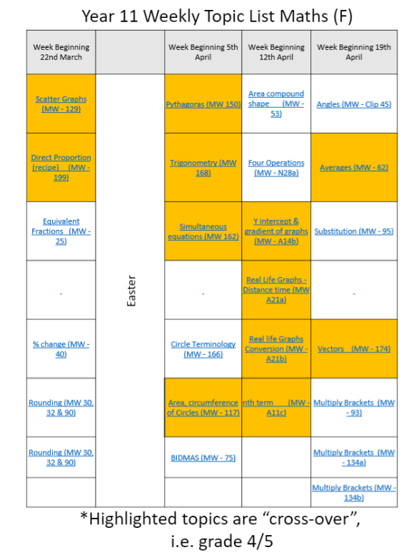
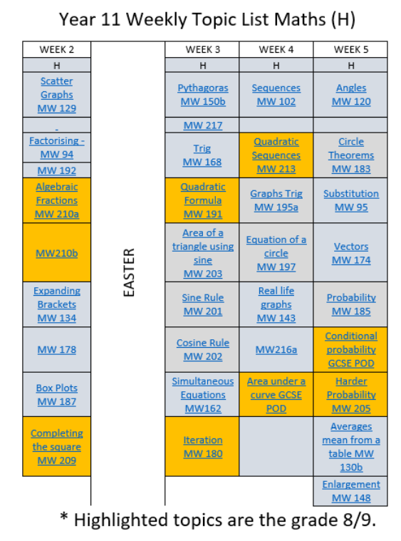

Slide 16
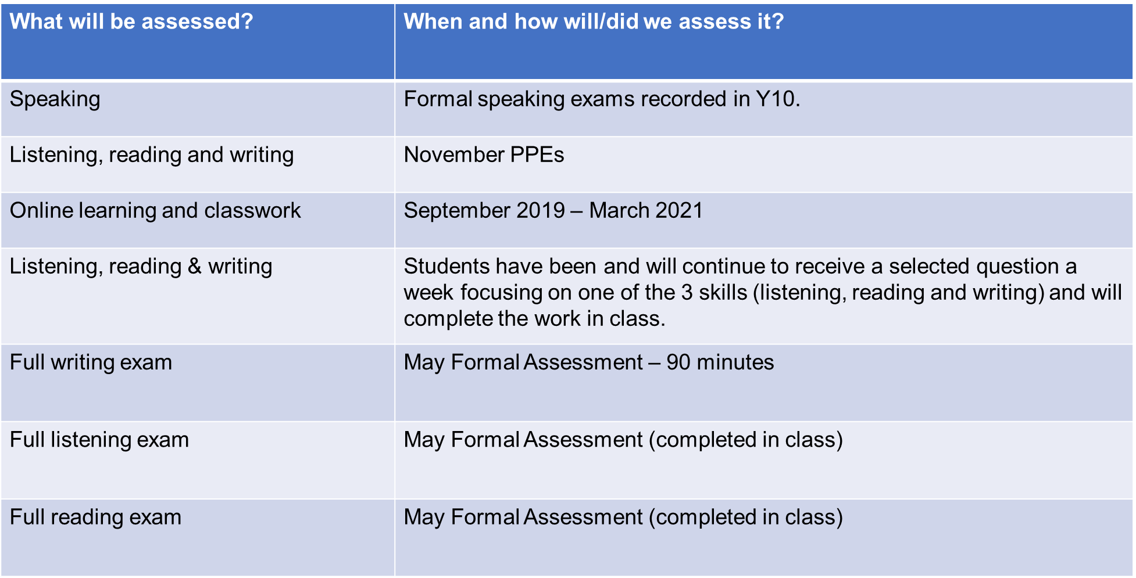
GCSE MFL (FRENCH/SPANISH)
BE KIND. WORK HARD.

Slide 17


BTEC MUSIC
Your teacher will look at all the work that you have produced during the course – this will be your 'Portfolio', and could be made up of finished projects, incomplete projects, or even individual tasks or pieces of work.
Your portfolio will be assessed over three units you have completed…
Unit 1 – The Music Industry - This unit was the exam that was assessed at Year 10. PPE marks will also be considered for those without a grade.
Unit 2 – Managing a Music Product – Assessed by your teacher, using the work you complete in school.
Unit 7 – Introduction to Music Sequencing – Completed unit and will count towards CAG
BE KIND. WORK HARD.

Slide 18
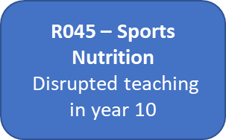
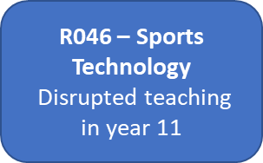
OCR SPORTS SCIENCE
One Mandatory unit plus the Strongest from the two optional units will be assessed.
Staff will look at where their average Learning Outcome (LO) mark is in relation to the mark bands (MB) set out within the assessment criteria. A unit score will be produced and based against the grade boundaries provided by OCR which are mostly consistent. This score will then generate the CAG.
Mandatory unit
R042 Applying the Principles of Training
Coursework was ready to be sent for moderation and will be considered when generating the CAG.
This unit can be improved if the student wishes to do so as marks could be re-submitted under normal non-covid conditions.
Optional unit
Strongest from the two optional units to be assessed, up to the point taught, against the assessment criteria for the relevant unit.
or
BE KIND. WORK HARD.

Slide 19
GCSE PHYSICAL EDUCATION
What will be assessed? | When and how will/did we assess it?
Paper 1 – The human body and movement in physical activity and sport | Students completed a full paper 1 PPE in November of year 11. This mark will be taken into consideration. Additional mini-assessments in class including a combination of multiple-choice, short and long answer questions.
Paper 2 – Socio-cultural influences and wellbeing in physical activity and sport | A modified paper 2 was completed in November of year 11. This mark will be taken into consideration. A full paper 2 will be taken during the formalised centre assessment period (78 marks, 1hr 15m). All assessments will have a proportional split of AO1, AO2, and AO3 marks in line with a standard paper.
Non-exam assessment | Students are required to be assessed in two sports (individual or team). Staff will analyse scores from the different sports and consider the two best scores. Students have completed the analysis of performance coursework. This will be assessed by staff. We may not be able to share these scores with you.
BE KIND. WORK HARD.

Slide 20

GCSE PHOTOGRAPHY
Your teacher will look at all the work that you have produced during the course – this will be your 'Portfolio', and could be made up of finished projects, incomplete projects, or even individual tasks or pieces of work.
Your portfolio will be assessed on our four key skills areas (Assessment Objectives)…
EXPLORE the work of other photographers - Researching, Analysing and Responding to their work
EXPERIMENT with Ideas, Processes and Techniques to create your own photographic images
EXPLAIN your ideas – visually through photoshoots, and textually through explanations and evaluations
EXPRESS a Personal Response to each theme that links back to previous work on that theme
BE KIND. WORK HARD.

Slide 21

GCSE COMBINED SCIENCE/SEPARATE SCIENCES
Weekly Test 1
Weekly Test 2
Weekly Test 3
Weekly Test 4
Weekly Test 5
Topics to be assessed in each test listed on the next page
Exam 1- Biology
75 Minutes
Biology paper 1 and paper 2 topics
Exam 2 -Chemistry
75 Minutes
Chemistry paper 1 and paper 2 topics
Exam 3- Physics
75 Minutes
Physics paper 1 and paper 2 topics
Professional decision made using evidence from weekly tests, exams & teacher assessment
BE KIND. WORK HARD.

Slide 22


Weekly In Class Assessments Topics
Weeks 1 and 2 | Weeks 3 and 4 | Week 5
Homeostasis | Cells | Infection and response
inheritance | Organisation | Bioenergetics
Ecology | Atomic structure | Energy changes
Waves | Bonding | Rates of Reaction
Magnets | Energy | Radiation
Forces | Particle model | Forces
Formal Assessments Topics in May
Biology paper 1 and 2 topics | Chemistry Paper 1 and 2 topics | Physics paper 1 and 2 topics
Cell biology | Atomic structure | Energy
Organisation | Bonding and structure | Particle model of matter
Infection and Response | Energy changes | Radiation
Bioenergetics | Rates of reaction | Forces
Homeostasis | Organic chemistry | Waves

Slide 23

Remember
Attend every day
Work hard in lessons
Follow teacher instructions
Complete assessments to the best of your ability

